Slide 1
PEP toolkit: sense of self
Virtual
School
Hampshire Virtual School

Slide 2
Sense of self – what is it?
Self-concept
Perception a child has of themselves, such as I am a pupil. I am a LAC
Ideal self
What or who would you like to be?
Self-esteem
Evaluation of the above. How important is your self-concept and your ideal self? How closely aligned are they?
Global self-esteem
Feelings of negativity about your abilities and self-concept in all areas (often linked to depression)

Slide 3
Indicators of children and young people with a negative self-concept
For example:
exploding into rage if thwarted
hypersensitive to criticism (or learning feedback resulting in task avoidance)
spoils the achievements of others
reacting defensively under perceived ‘threat’ (the way someone may have looked at them)
imagining others are against them (personalisation of feedback/comments)
difficulty taking responsibility (blaming others, denying, making excuses, projecting
behaviour onto others)
appear listless, lacking in motivation
difficulty accepting disapproval/praise
difficulty relating to things they are good at
negative body image
high levels of anxiety in the classroom (including controlling behaviours)
difficulty asking for help or not knowing things/overly dependent on others to help them
people pleasing (fawning and flocking – linked to fight/flight/freeze)
toxic shame

Slide 4
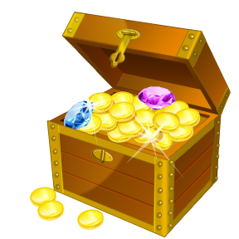
Developing a positive self-concept: finding hidden treasure
I’d like to take the chance to get to know you better, so I’d like to hear about the sorts of things you enjoy.
What could you start by telling me? What would you say you are quite good at? It could be at home or school.
Who else, apart from me, knows you are good at…?
If they were here right now, what else would they tell me about you that would be interesting?
At the end of the session, take time to feed back to the pupil all that you have learnt about them, outline the strengths that have been revealed.

