Slide 1
PEP toolkit: emotional and behavioural regulation
Virtual
School
Hampshire Virtual School

Slide 2
Emotional and behavioural regulation
Self-regulation (or self-control) is also an executive function. Children who have experienced inconsistent attachments/trauma often find it more difficult to manage their behaviours than others.
These children may present as finding it more difficult to:
label emotional states (which helps us control them)
link their physiological indicators of arousal with their emotions (interoceptive awareness)
separate their emotions from actions (acting out)
the internalisation of rules (understanding what is acceptable behaviour in differing contexts)
plan ahead – working towards goals
be sensitive to triggers in their environments – social, learning and sensory

Slide 3
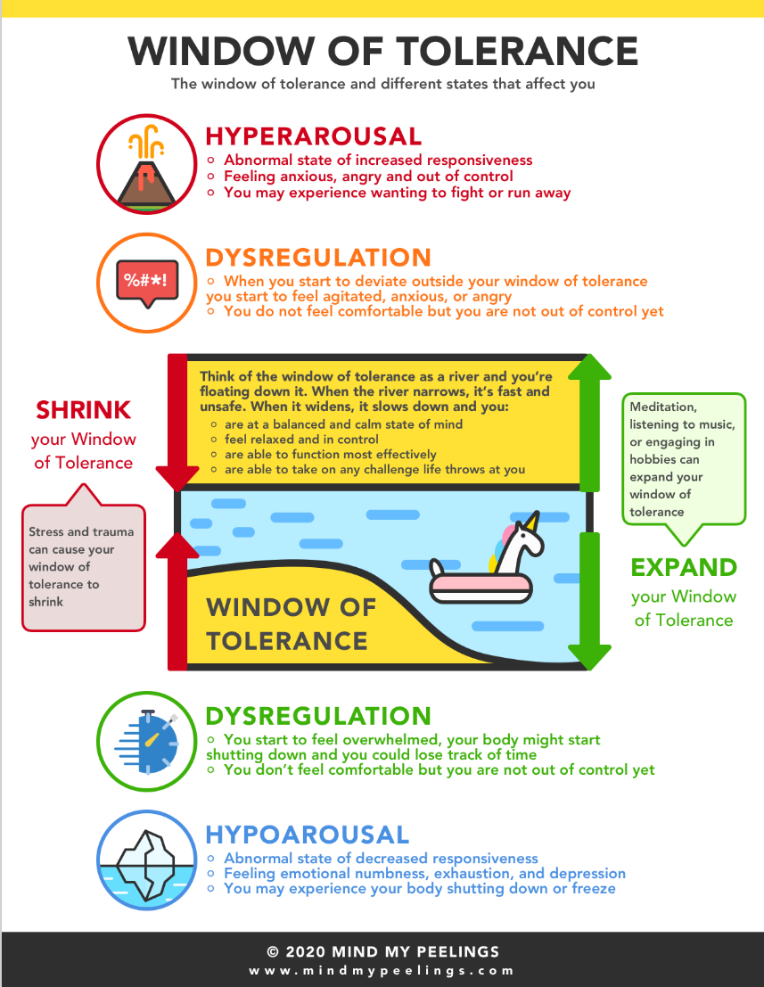
Emotional and behavioural dysregulation: window of tolerance – fight/flight/freeze response
Window of tolerance (Dan Siegal, 1999)

Slide 4
Indicators suggestive of emotional and behavioural regulation
Such as:
difficulty calming down after an altercation (approximately 1/5 hours before getting back to optimal levels of arousal)
having uncontrolled emotional outbursts (anger, anxiety, distress)
poor frustration tolerance – difficulty controlling reactions
overreaction to attention (may become loud, overexcited)
sensory regulation difficulties (this is often related to early neglect). Children can be triggered by noise, visual stimuli, textures, sudden movement, smells, seeking proprioceptive input through activities such as fiddling, climbing, rough-housing/handsy and vestibular input through movement and fidgeting.
This leads to:
attention regulation difficulties (distractible)
difficulties with unstructured time
experiencing overwhelming feelings that do not appear to have triggers.
overreacting to unseen triggers (memories, curriculum howlers, reminders, similarities by look, smell, etc).

Slide 5
Managing emotional and behavioural regulation
Connection before correction approach – Dan Siegal
During periods of heightened emotions when children are dysregulated it is important to learn, think and reflect.
Children need to learn to calm their fight/flight response.
Relating: this requires relating and connecting through attuned adult-sensitive relationships
Only when fight/flight is calm can adults use reason to develop reflection
The process of ‘co-regulating’ is essential to learn to self-reflect
Children need to feel physically and emotionally settled to do this
Children need to feel comfortable, safe and connected.
Children can then access the reason, learn to problem solve, and reflect on alternative solutions
See Emotion Coaching and PACE slides
Flipping Your Lid can be shared with children: The Hand Model of the Brain (youtube.com)

Slide 6
Sensory Regulation
Sensory audit for schools and classrooms (education.gov.scot)
Sensory-processing-pack-for-schools-KS1-4.pdf (leicestershire.gov.uk)
NCSE - sensory spaces in schools
Autism-education-trust-sensory-assessment-checklist.pdf (birmingham.gov.uk
Grounding techniques that involve your children — Atlanta wellness collective | expert guidance to live life well (atlwell.com)

Slide 7
Co-regulation strategies
Identify
Identify the feelings in the body: help the child/young person identify their feelings. You may need to do some body awareness activities. Social and emotional aspects of learning (SEAL) resources have useful ways to do it.
Teach
Teach them feeling words: the child/young person will need to develop a feelings vocabulary. You can do this by labelling the feelings for the child/young person and then carrying out emotional literacy work around identifying feelings.
Wonder
Wonder aloud using empathic commentary: adults provide a commentary for the children/young people and wonder aloud (“I think you may be feeling like this … as I noticed …”)
Develop
Develop self-awareness: teach children to differentiate behaviours, thoughts and feelings.
Need
Children in fight/flight will need adult co-regulation: pupils in a fight/flight state and, subsequently, high levels of arousal will find it hard to sit still or regulate their behaviour. They will need an adult to do this for them.
Do not use
Do not use behavioural approaches: do not offer choices or use sanction-driven language when a child is dysregulated. It is not effective and can escalate a situation.

Slide 8
Sample strategies from the toolkit: emotional and behavioural regulation
Teaching children to use their inner quiet voice to self-regulate
Have I felt like this before?
What did I do to feel more positive?
Who helped me?
How did I feel afterwards?
Did I talk to myself? (what did I say?)
What makes me feel in control?

