Slide 1
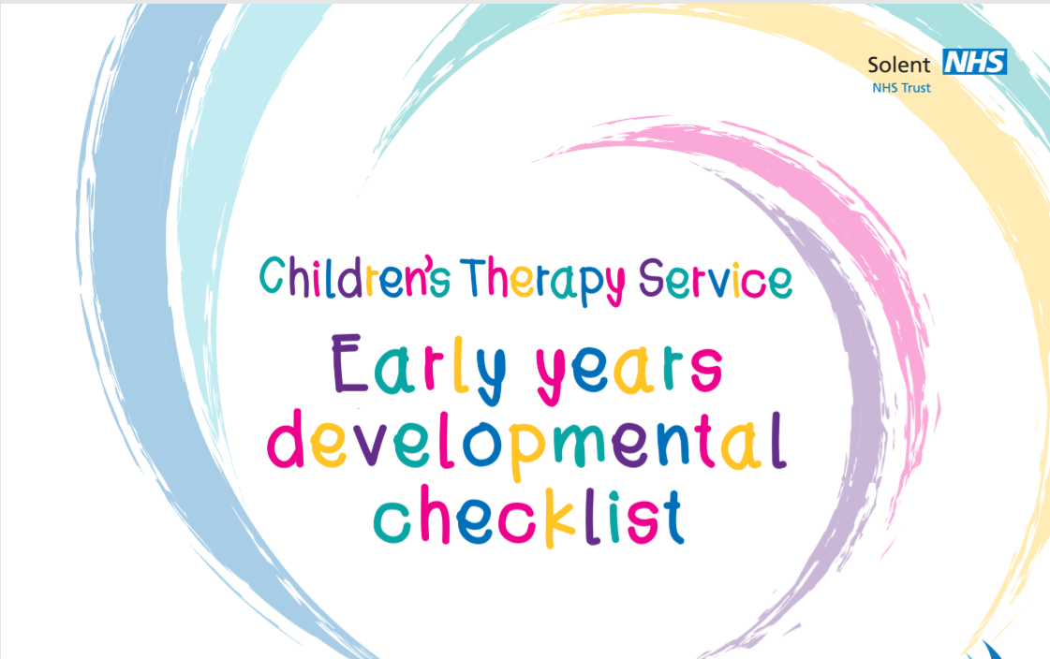
School and PVI Setting application info
Support toolkit and Information
(To support Practitioners of Early Years Looked After Children)
Best Provision Protocol – who does what when applying for an education setting place?
EYE funding forms (to be used when applying for preschool, childminder and nurseries) and information re funding streams
Decelerating Child’s entry to school
Admissions guidance and information on Looked after children and school applications
Finding childcare – Family information and Services Hub
School catchment area finder (how to find a local school)
How to make a school application (HCC)
During visits to EYFS settings and schools, the Early Years Advisers from Virtual School and Services for Young Children (SfYC) often share a toolkit of documents and links to support ‘raising outcomes’ for our Care Experienced children.
We thought it would be useful for Designated Leads in PVI settings, Designated Teachers and Class teachers to have a list of our bank of resources….
Key Early Years Documents and Books:
Development Matters in the EYFS
Birth to 5 matters
What to Expect When
Children’s Therapy Service: Early Years Developmental Checklist
Child development books such as Mary Sheridan or Jennie Lindon etc
Visit the Virtual School Moodle for more leaflets and information
https://virtualschool.hants.gov.uk/
Any further questions, comments or suggestions? Please contact us…
virtualschool@hants.gov.uk

Slide 2
Virtual School and Statutory documents..
Attachment and trauma
Corporate Parenting principles for Looked After Children
Designated teacher (or Designated Lead) for Children in Care Guidance
Promoting the education of Looked After Children and Previously Looked After Children
Behaviour and Attendance guidance. Resources for schools
School Evaluation Framework (SEF)
Anna Freud National Centre for Children and Families
Braveheart - Attachment and Trauma
Social and Emotional Aspects of Development (EYFS)
Barnardos – Key person approach
Hampshire and Isle of Wight Attachment and Trauma resources
Adoption
Useful links
Adoption UK – Lets learn together (information leaflet)
Schools guide for adopted children and permanently placed children
Hampshire and Isle of Wight Virtual School and College for children in care website
Virtual School Moodle
NSPCC
EYPP, 2 year old funding, Pupil Premium
PEPs
Email addresses
.
Virtual school :
Virtual school@hants.gov.uk
Moodle access: vsmoodle@hants.gov.uk
EYPP
HCC EYE funding for 2
HCC EYE funding for 3 and 4 year olds
EY PEPs and Guidance
Yr. R PEPs and Guidance ​
all PEPs are emailed to:
HCC.PEPs@hants.gov.uk

